Slide 1

Computerized Maintenance Management System (CMMS) for Radiation Therapy
Health technology management System
School of Biomedical Engineering
Addis Ababa Institute of Technology

Slide 2
Group Members
1. Natnael Abayneh…………………………………..UGR/8829/13
2.Dagnachew Tilahun ……………………………….UGR/5514/13
3.Amanuel Zewdu……………………………………..UGR/9255/13
4.Aragaw Hussen………………………………………UGR/1178/13
5.Alebel Melak ………………………………………..UGR/5507/13
6.Rumman Murad……………………………………UGR/6778/13
2

Slide 3

Introduction
01
Literature Review
Project Overview
02
System Design
03
Tools and Technologies
04
Result and Discussion
05
Demonstration
06
3

Slide 4
1. Introduction

Slide 5
What Is CMMS
A Computerized Maintenance Management System (CMMS) is a software solution designed to streamline and automate maintenance operations.
Why It Matters
Most of the systems have manual maintenance system that limits the management system
Why it is needed
To enhance radiation therapy equipment reliability, patient safety, and compliance with Ethiopian healthcare standards.
5

Slide 6
2. Literature Review

Slide 7
Ethiopian Hospital Services Transformation Guidelines
WHo's Computerized Maintenance Management System Guide
Database Management System (DBMS) Principles

Slide 8
3. System Design

Slide 9
Alerts track notifications with ID, Type, Severity, Equipment link, and Acknowledgment Status.
Compliance Reports manage regulatory documents with ID, Type, Equipment, Status, Findings, and Review
Maintenance Schedules handle work orders with ID, Equipment/Technician, Type, Priority, Dates, and Status.
9

Slide 10
System design centers on entities and relationships from database schemas.
Equipment entity tracks radiation therapy devices with details like ID, Name, Model, and Status.
Technician entity manages maintenance staff with ID, Name, Specializations, and Assigned Equipment.
10

Slide 11
Relationship
Equipment (1) ↔ (N) Maintenance Schedule (one equipment can have many maintenance records)
Technician (1) ↔ (N) Maintenance Schedule (one technician can handle many maintenance tasks)
Equipment (1) ↔(N) Alert (one equipment can generate multiple alerts)
Equipment (1) ↔ (N) Compliance Reports (one equipment can have multiple compliance reports)
11

Slide 12
Features
Maintenance history
Preventive/Corrective Maintenance Scheduling
Alert Generation System
Reporting Dashboards
Compliance Reporting
12

Slide 13
4. METHODOLOGY

Slide 14
Tools and technologies

Slide 15




Backend Database
Styling UI
Implemented using MySQL with MAMP server, Node JS and Express.
Dynamic behavior
Frontend Design
React.js-based interface and Boot strap
Local host
Frontend interface
14

Slide 16
5. Result and Discussion

Slide 17
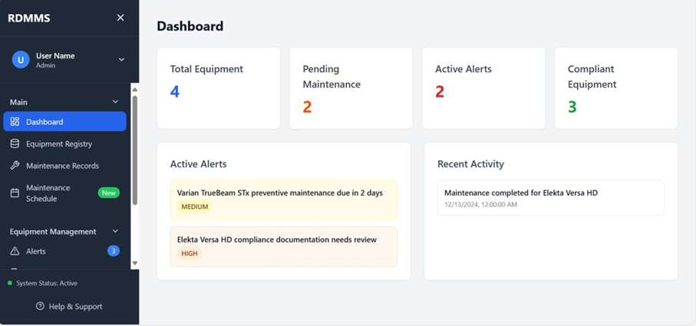
Fig. 2 Dashboard Tab
The central control panel of Our Radiation Therapy Device Management System (RDMMS).

Slide 18
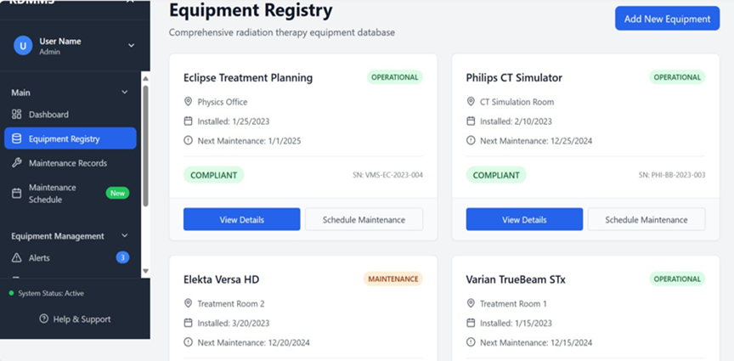
Fig 3 Equipment Registry Tab
The master database for all radiation therapy equipment.

Slide 19
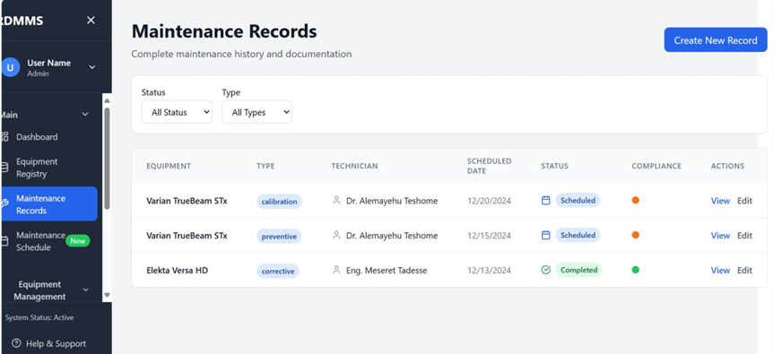
Fig. 4 Maintenance Records Tab
It represents maintenance activities (preventive, corrective, emergency) performed on radiation therapy equipment.

Slide 20
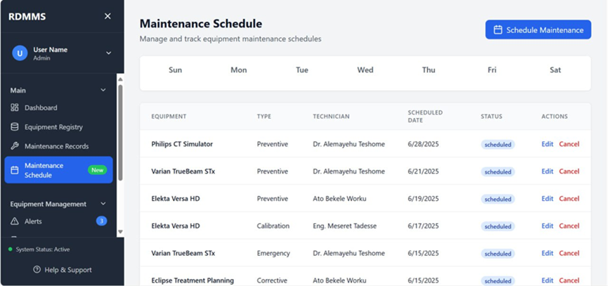
Fig. 5 Maintenance Schedule Image tab
allows administrators to view, manage, and track upcoming and past maintenance tasks for radiation therapy equipment.

Slide 21
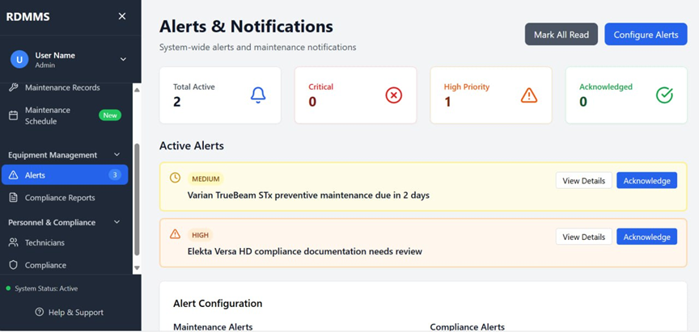
Fig. 6 Alerts and Notifications
Provides a centralized notification hub for critical system events, maintenance deadlines, and compliance issues.

Slide 22
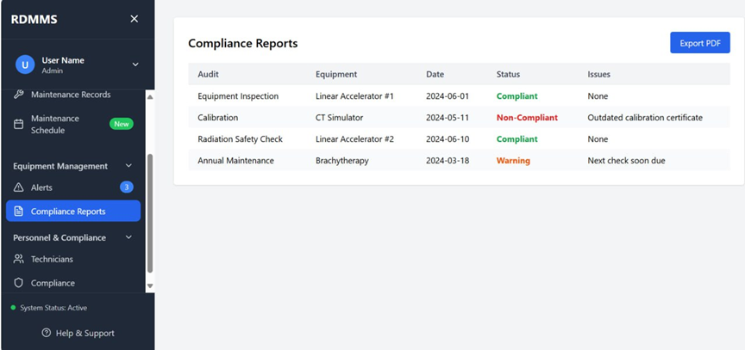
Fig. 7 Compliance Reports
Provides a centralized audit log of regulatory checks, safety inspections, and equipment certifications.

Slide 23
6. Demonstration

Slide 24
We appreciate your attention
Any Questions?
Thank You
We're happy to address any questions regarding the topic
23

